Slide 1
lINUX
BASICS OF COMMAND LINE INTERFACE

Slide 2
understanding HOW COMMANDS ARE STRUCTURED
The general command structure is
“Commands”
“Options”
“ Arguments”

Slide 3
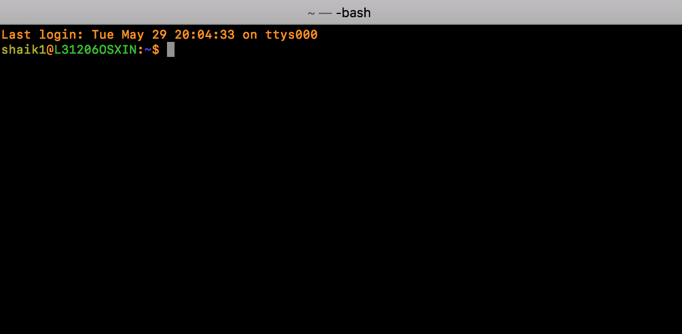
PROMPT

Slide 4
HELP FOR COMMANDS
“ HELP “
The help command shows a short list of the commands built into the Bash shell itself.
“man”
The man command shows detailed manuals for each command. These are referred to as “man pages.”
For example, if you wanted to view the man page for the wget command, you’d type man wget. Man pages generally contain much more detailed information than you’ll get with the -h or –help options

Slide 5
explore AND NAVIGATE
Finding Out Where You Are with “ pwd “
We can ask our server what files and directories are in the current directory with a command called ls. “ ls “
We can move around the file hierarchy by using the “ cd “command. This command stands for change directories.

Slide 6



CREATE AND REMOVE FOLDERS
The “ touch ” command creates a new empty file.
The “ mkdir ” command creates new directories.
You can permanently remove files from the directory hierarchy with the rm command.

Slide 7
COPY, MOVE AND DELETE FILES

Slide 8
find FILES

Slide 9
UNDERSTANDING USER ROLES

Slide 10
UNDERSTANDING FILE PERMISSIONS

Slide 11
USING PIPES

Slide 12
CAT, HEAD, TAIL AND LESS

Slide 13
SEARCH FOR TEXT AND STREAMS

Slide 14
MANIPULATE TEXT WITH AWK, SED AND SORT

Slide 15
EDIT WITH VIM

Slide 16
searching FOR THE LINUX VERSION

Slide 17
TAR, ZIP AND ARCHIVES

Slide 18
STDIN, STDOUT,STDERR

Slide 19
SHELL SCRIPTING BASICS

